Slide 1
Chap. 2 Fundamentals of Electric
Circuits
Kirchhoff’s laws
Circuit Analysis: Basic Methods
Dependent Sources

Slide 2
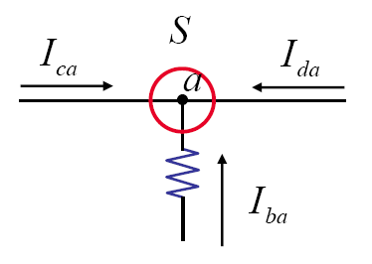
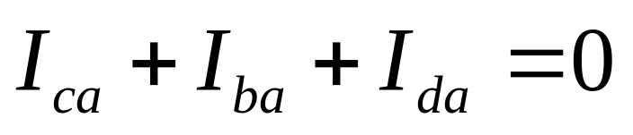
KCL (Kirchhoff’s Current Law)
The sum of all branch currents flowing into a node is zero – charge conservation.

Slide 3
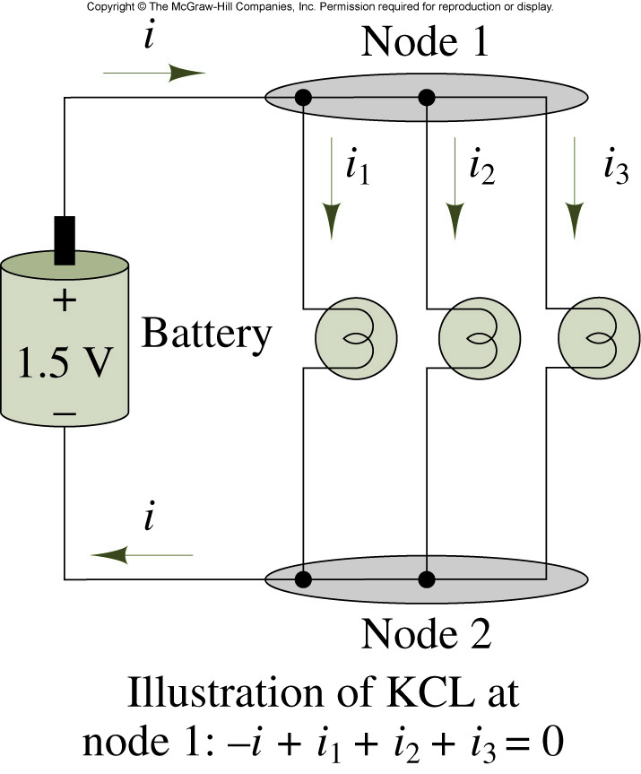
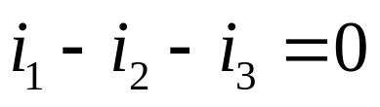
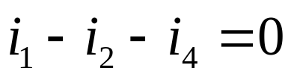
Illustration of Kirchhoff’s current law
G
B 1 A 3 C
2
5
4
D
Node:
G:

Slide 4
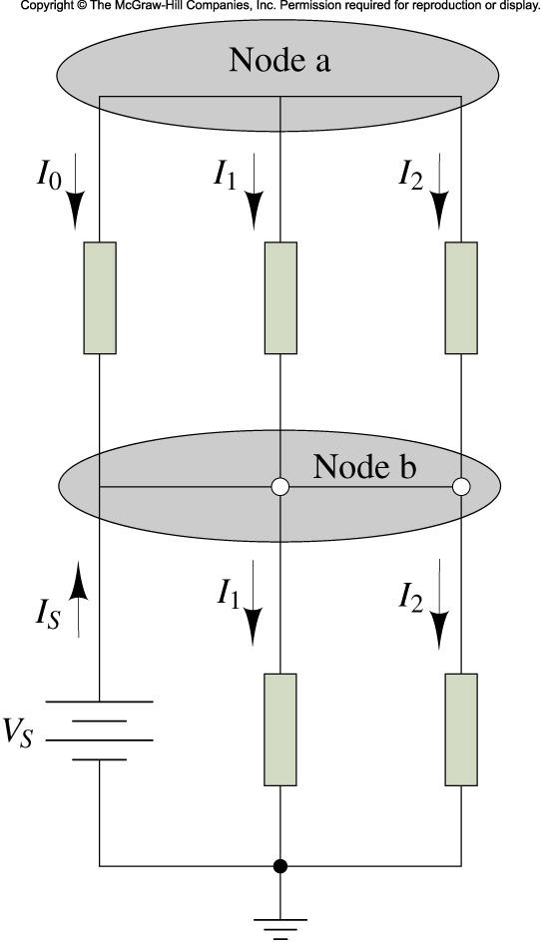
Demonstration of KCL
Is = 5A, I1 = 2A, I2 = -3A, I3 = 1.5 A
_{Find I0 and I4}

Slide 5
Example
i2
i1
G
i3
i4
i5

Slide 6
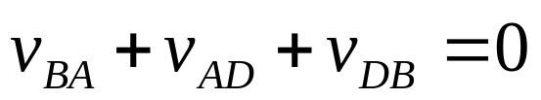
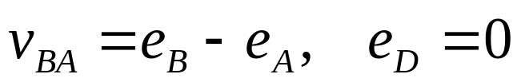
KVL (Kirchhoff’s Voltage Law)
The algebraic sum of the branch voltages around any closed path in a network must be zero
G
B 1 A 3 C
2
5
4
D
(a)
(b)
Node sequence B,A,D,B:
Using node voltages:
(reference node = D, reference voltage = 0)

Slide 7
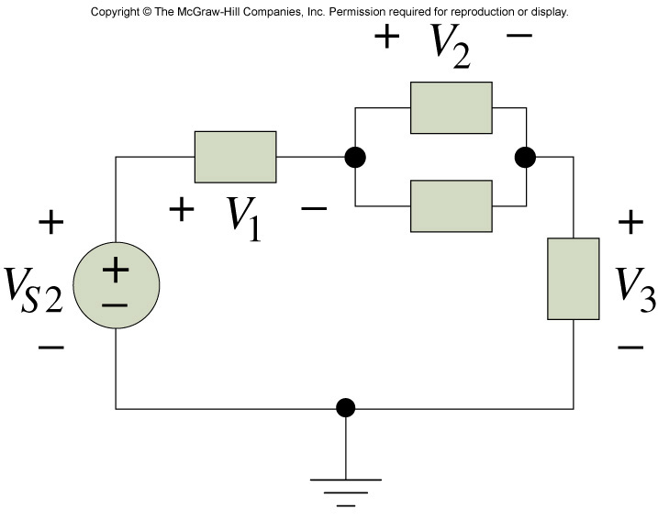
Example
_{Vs2 = 12 V, V1 = 6V, V3 = 1V}
_{Find V2.}

Slide 8
Some Useful Facts
The branch currents passing through series-connected elements must be the same.
The voltages across parallel-connected elements must be the same.

Slide 9
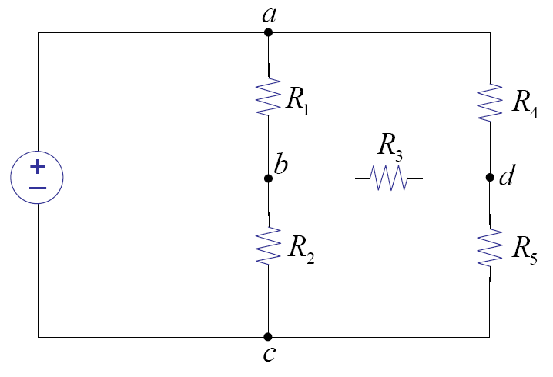
Independent Equations
How many independent KCL equations can be made?
How many independent KVL equations can be made?

Slide 10
Circuit Analysis: Basic Method
Goal: find all V and I s for all elements
  Write element’s V-I relationships
  Write KCL for all nodes
  Write KVL for all loops

Slide 11
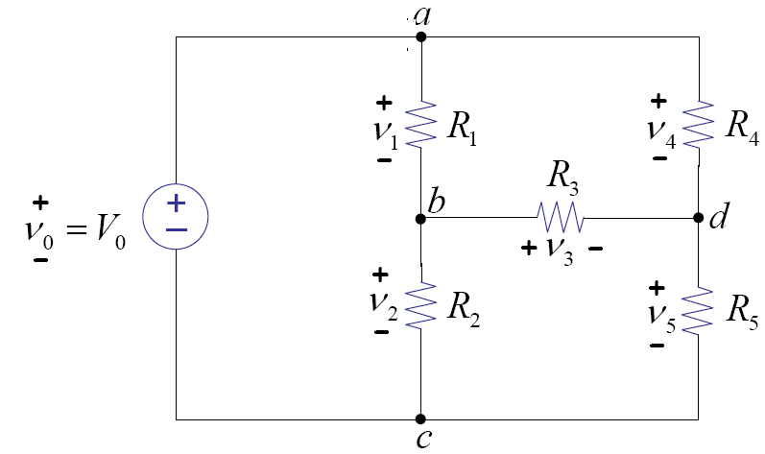
Example
Element’s equations
KCL
KVL

Slide 13
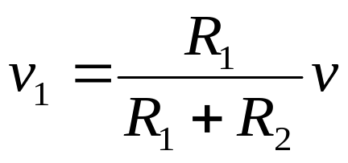
Voltage Divider and Series Resistors
A
i
A
i
+
+
v₁
R1
+
v
-
v
Req
R2
B
B
(a) Voltage divider
(b) Equivalent resistance

Slide 14
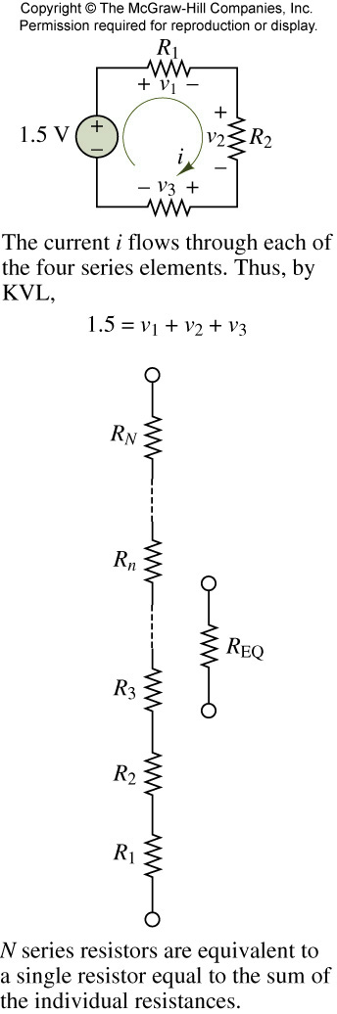
R1 = 10 kOhm, R2 = 6 kOhm, R3 = 8 kOhm
_{Find V3.}

Slide 15
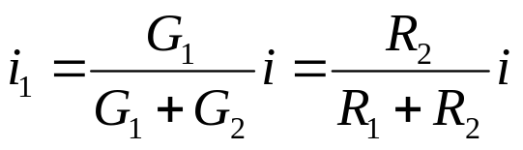
Current Divider and Parallel Resistors
A
A
+
i
i
+
v₁
R₁
R₂
v₁
Req
-
i₁
i₂
-
B
B
(a) Current divider
(b) Equivalent resistance

Slide 16
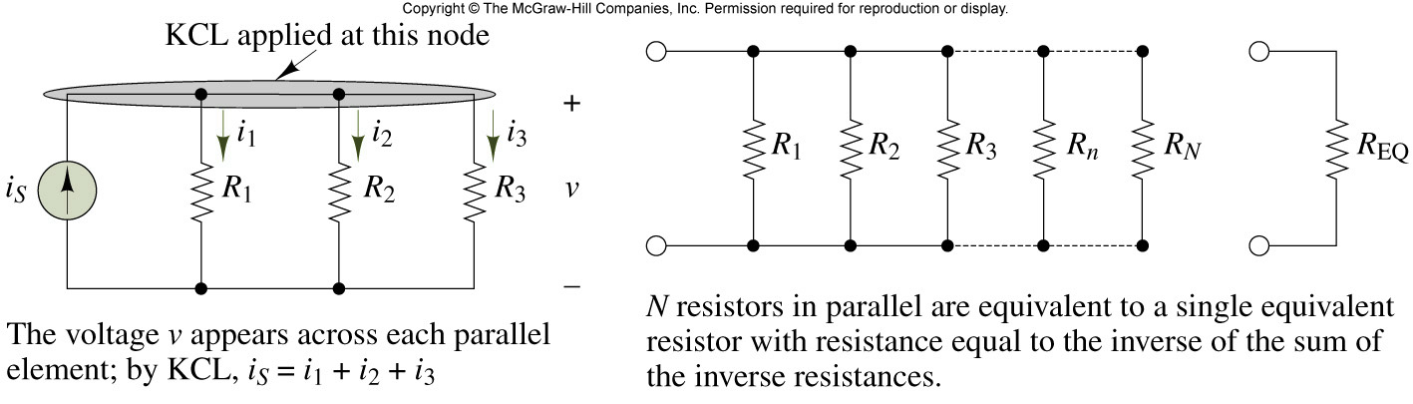
Parallel circuits

Slide 17
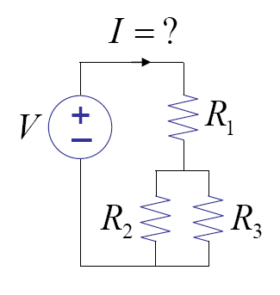
Example 1

Slide 18
Example 2
Find the voltage (v) between nodes A and B.
+
v
-
C
Α
Β
3Ω
3Ω
10V
4Ω
2Ω
2Ω
D

Slide 19
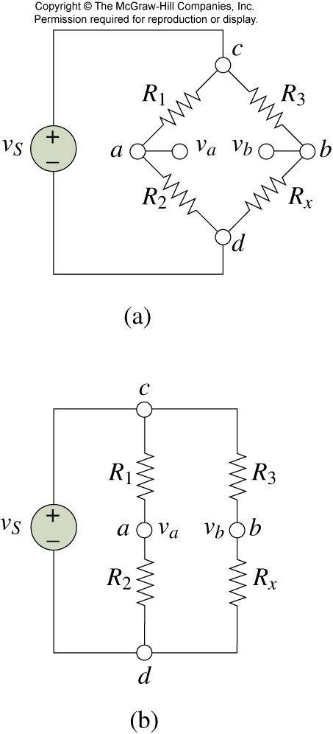
Wheatstone bridge circuits
_{R1 , R2, R3 are known}
_{Find Rx by measuring Vab}

Slide 20
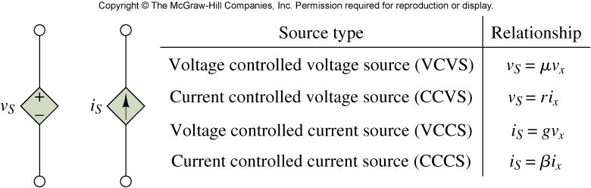
Symbols for dependent sources
Figure 2.4
o
o
o
o
o
o
o
o
+
+
v₁
+
v= μ v₁
i
+
v= ri
v₁
i= gv₁
i
-
-
o
o
o
o
o
o
o
o
(b) CCVS
(d) CCCS
(a)VCVS
(c) VCCS

Slide 21
Example 3
1Ω
i₁
A
+
v₁
-
What is the current on 2 Ω resistor?
i₂
2
₊
--
v₁
2Ω

Slide 22
Example 4
Find v. How much power does 4 ohm resistor consume?
10V
+
A
B
i
v
2i
4Ω
2Ω
−
2v
+−
D
C
Now, the voltage source is changed from 10V to 5V. How much power dies 4 ohm resistor consume?

Slide 23
Conclusion
Kirchhoff’s current and voltage laws
Basic Circuit Analysis Method
Series-parallel circuits
Dependent Sources

Slide 24
Chap. 3 Network Theorems
Node (voltage) analysis
Mesh (current) analysis
Superposition principle
Thevenin/Norton equivalent circuits

Slide 25
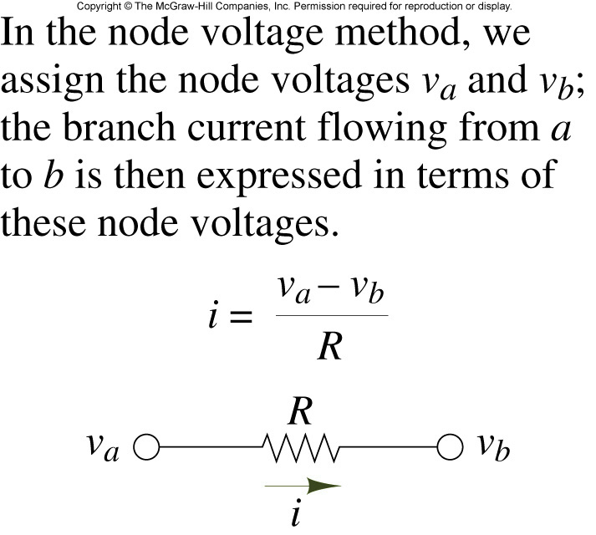
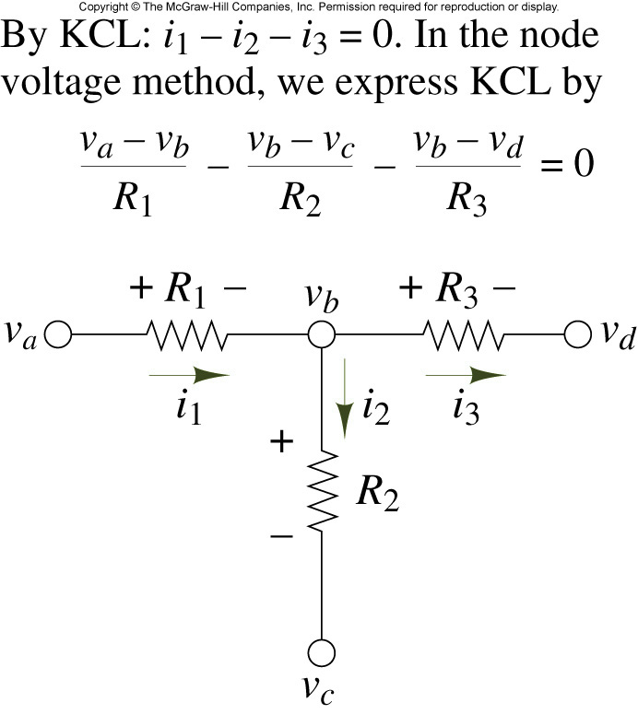
Branch current in Node Analysis

Slide 26
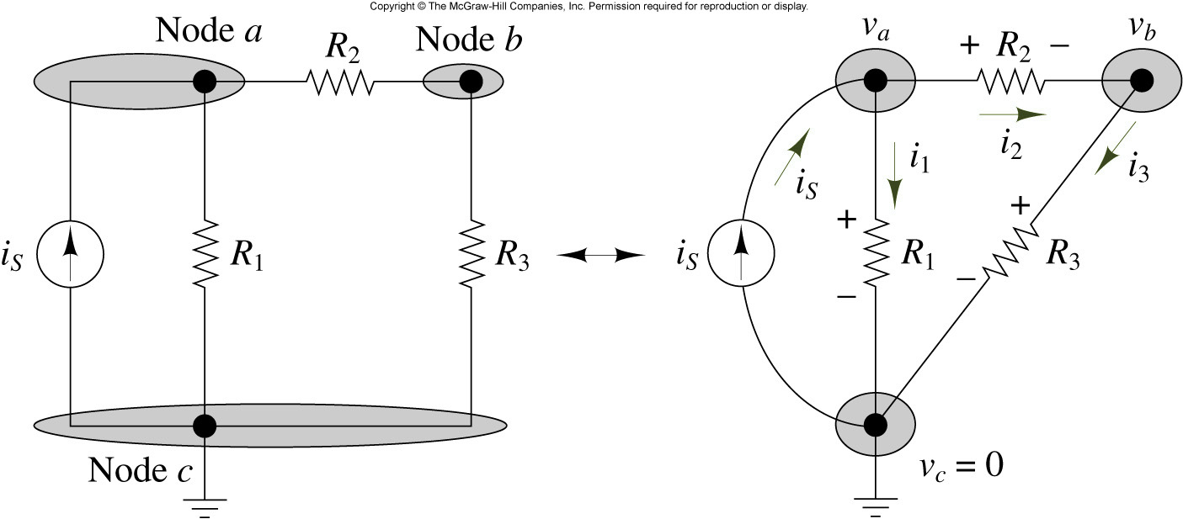
Illustration of Node Analysis

Slide 27
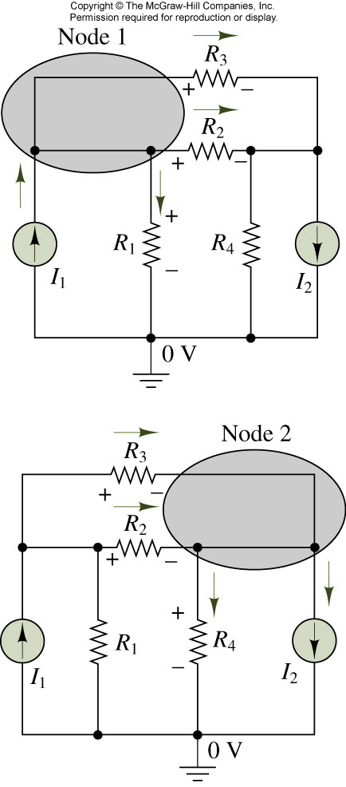
Example
I1=10mA, I2=50mA, R1 = 1k, R2 = 2k
_{R3 = 10k, R4 = 2k}
Find all node voltages and branch currents

Slide 28
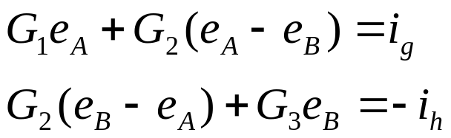
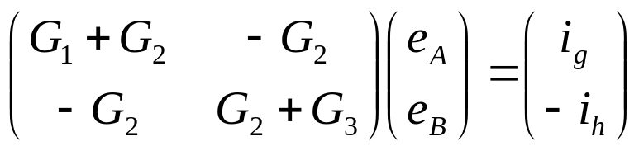
Matrix Formulation
A
R2
B
2
A
B
ig
R1
R3
4
1
3
5
ih
(a)
(b)

Slide 29
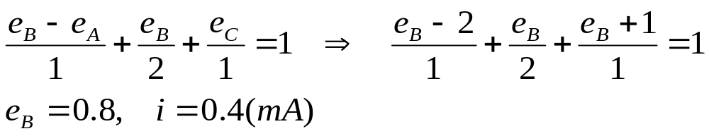
Node Analysis with Voltage Source
1kΩ
1V
1kΩ
A
B
C
A
B
-
-
+
1
i
2
4
3
2V
2k
1mA
+
D
(a)
(b)

Slide 30
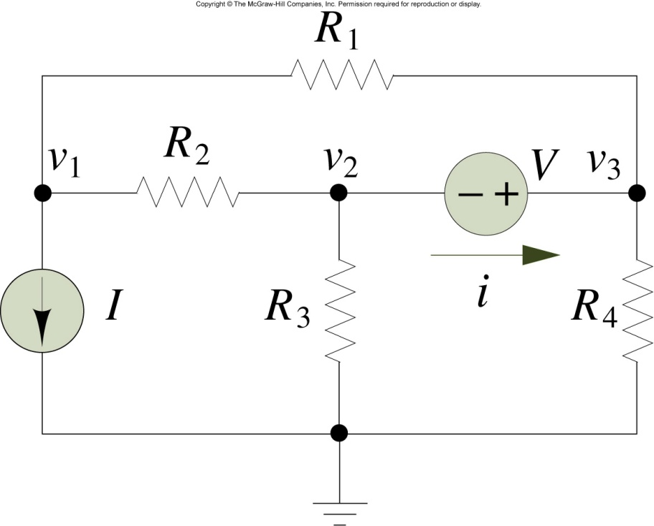
Circuit for Example
I = 1A, V = 3V, R1 = 2, R2 = 2
_{R3 = 4, R4 = 3}
_{Find i}

Slide 31
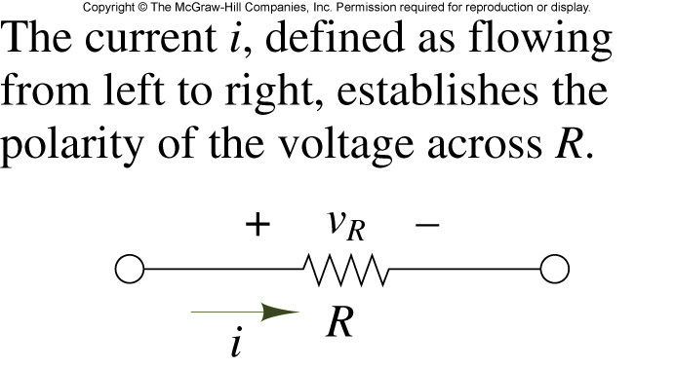
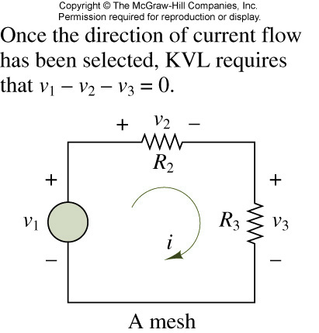
Basic principle of Mesh(Loop) Analysis

Slide 32
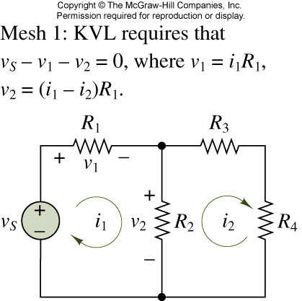
A two-mesh circuit

Slide 33
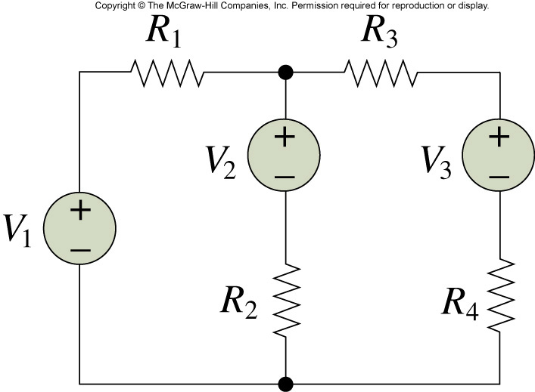
Example
_{V1 = 10V, V2 = 9V, V3 = 1V,}
R1 = 5k, R2 = 10k, R3 = 5k, R4 = 5k
_{Find i}

Slide 34
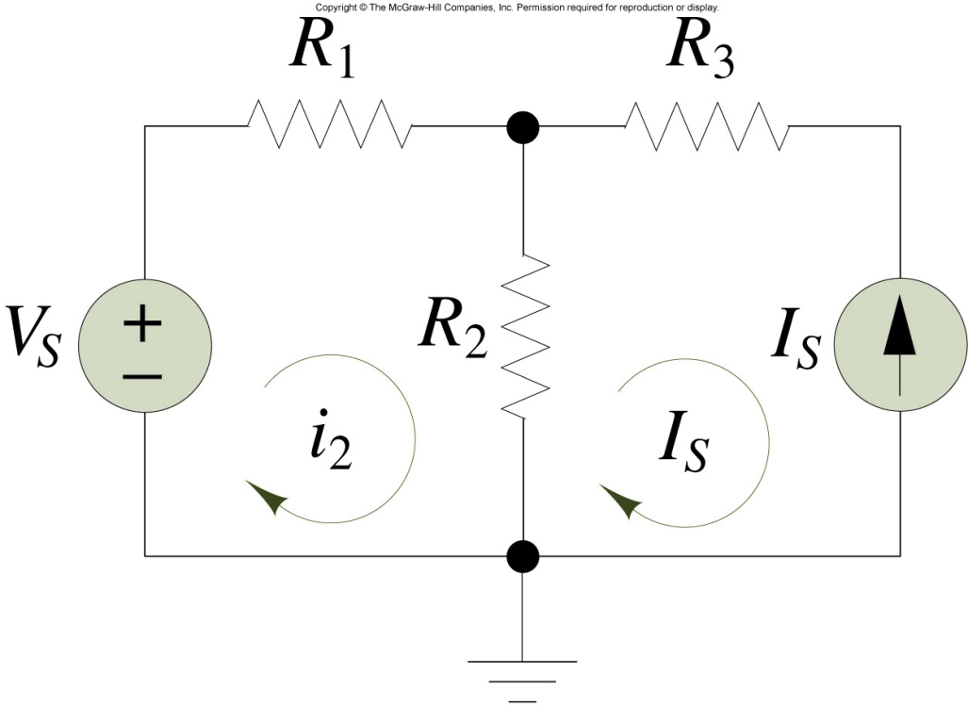
Mesh Analysis with Current Sources

Slide 35
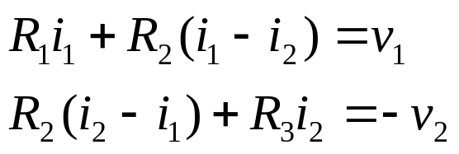
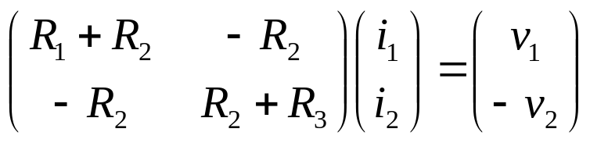
Matrix Formulation
R₁
R₃
A
B
C
i₁
i₂
v₁
₊
₋
R₂
₊
₋
v₂
D

Slide 36
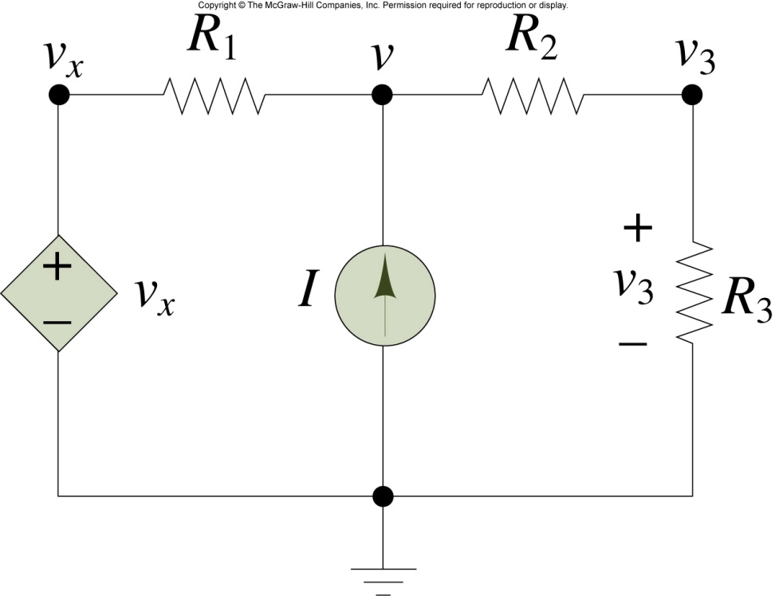
Node Analysis with Controlled Sources
_{I = 0.5mA, Vx = 2 x v3}
_{R1 = 5k, R2 = 2k, R3 = 4k}
_{Find v}

Slide 37
Exercise
Find i using the node analysis technique
1k
4i
A
B
C
+ -
2V
+
2k
2k
>
i

Slide 38
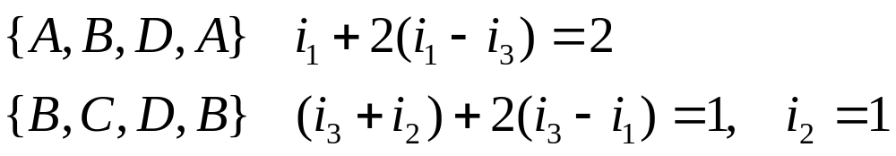
Loop Analysis
1k
1V
1k
A
B
C
-
+
i₂
2V
+
i₁
2k
1mA
i₃
D

Slide 39
Exercise
Find v using the loop analysis technique.
1k
2k
A
B
C
8
+
2v
+
2
1k
D
E
+ v -

Slide 40
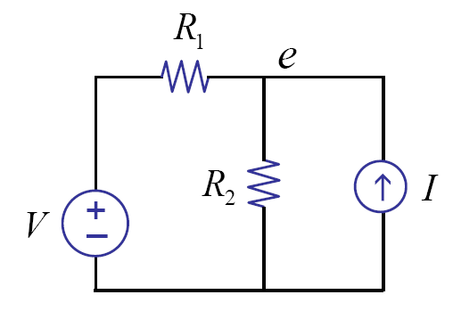

Linearity
Write node equations
Linear in V and I

Slide 41
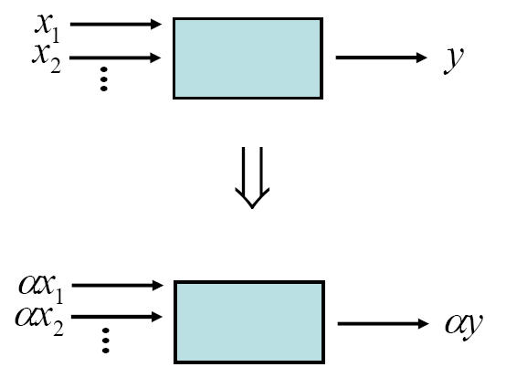
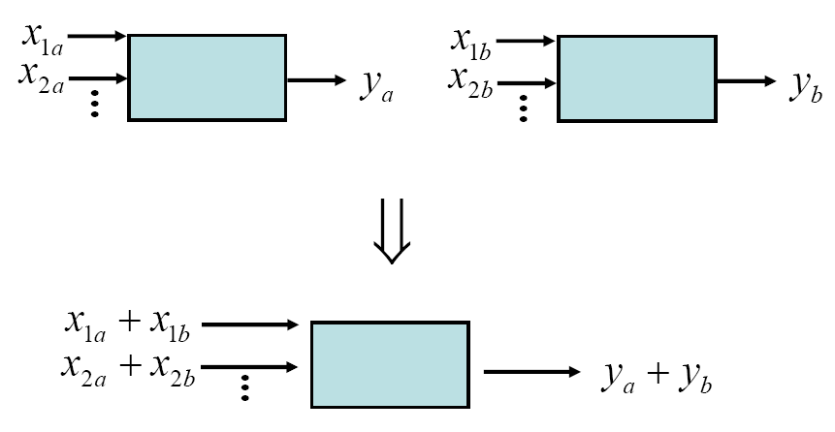
Linearity
Homogeneity
Superposition

Slide 42
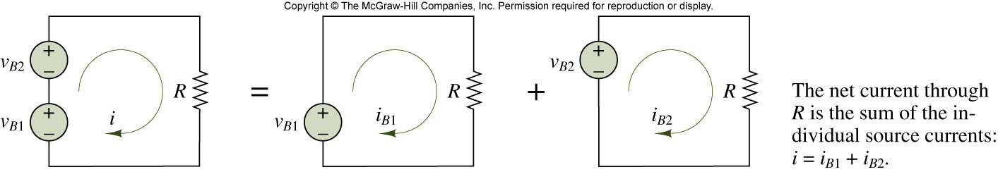
Superposition Principle

Slide 43
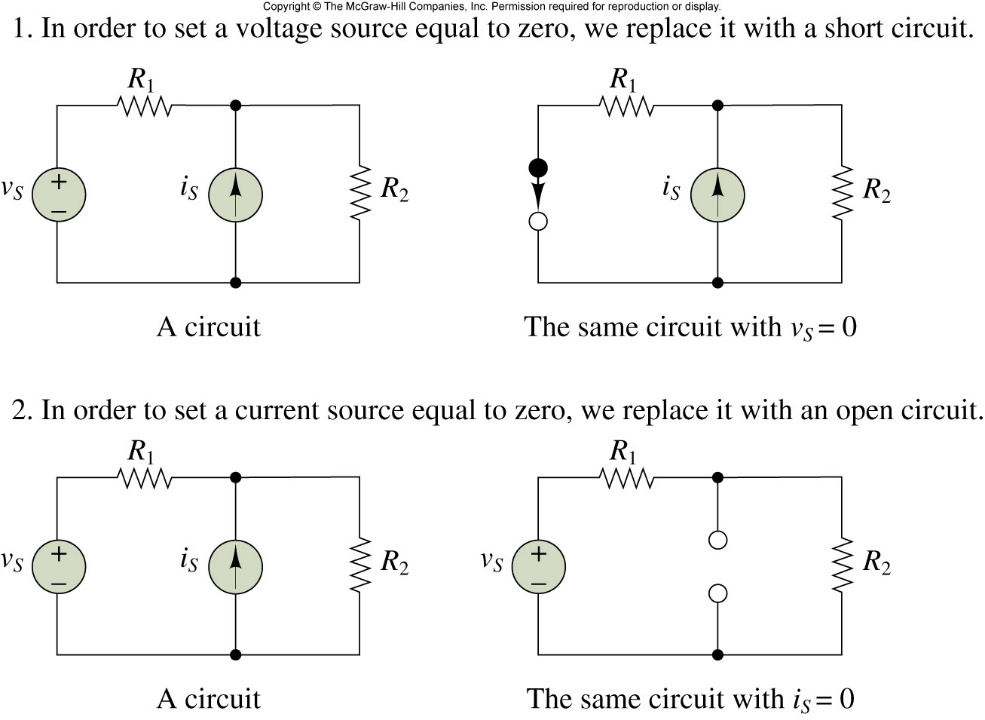
Zeroing Voltage and Current Sources

Slide 44
Exercise
1Ω
A
1Ω
v₁
+
2V
2A
4Ω
+
2V
4Ω
1Ω
2A
4Ω
i
i₁
i₂
(a)
(b)
(c)

Slide 45
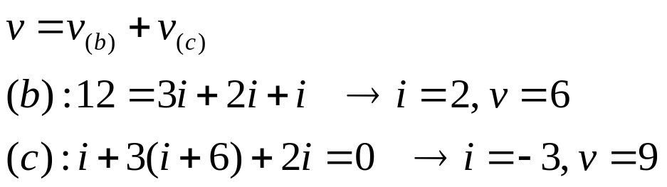
Superposition with Controlled Sources
i
12V
i
12V
i
A
-
-
+
+
+
v
-
+
v
-
+
v
-
3Ω
3Ω
1Ω
3Ω
1Ω
6A
1Ω
6A
+
+
+
2i
2i
2i
B
(a)
(b)
(c)

Slide 46
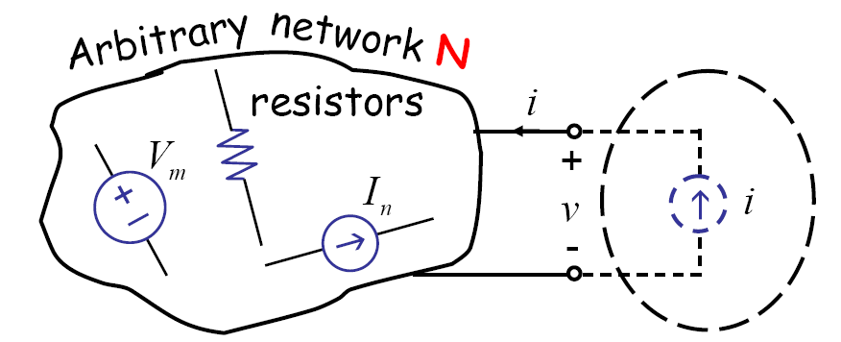
Deviation of the Thevenin’s Network
Consider

Slide 47
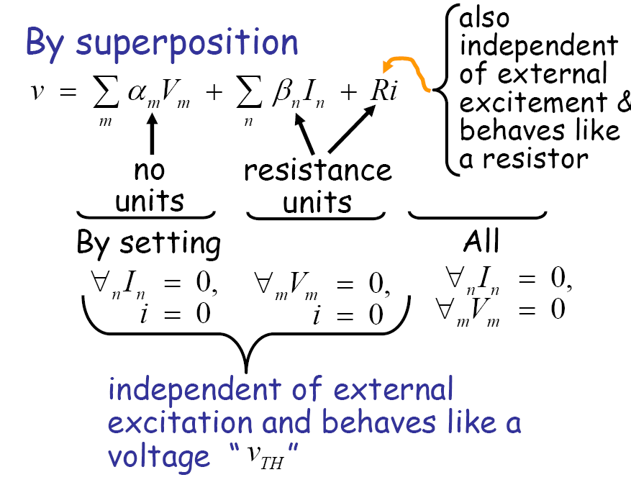

Slide 48
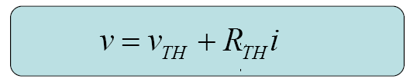
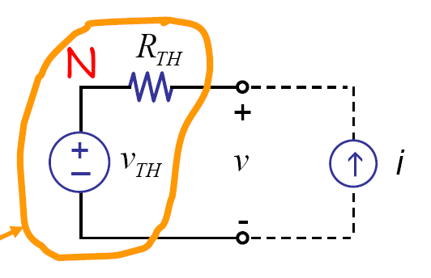
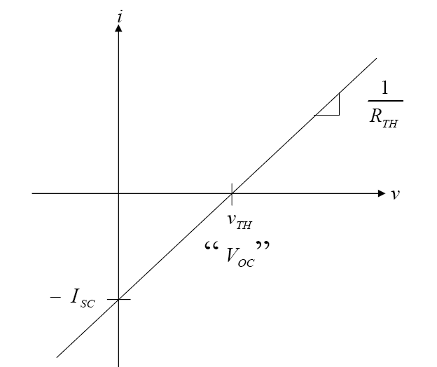
Thevenin equivalent network
Thevenin equivalent
network

Slide 49
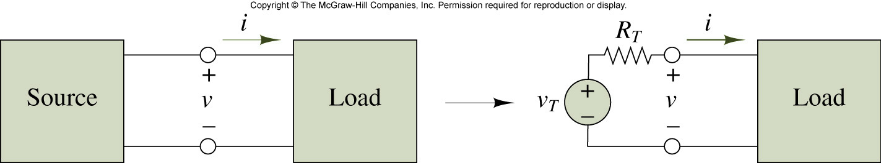
Illustration of Thévenin theorem

Slide 50
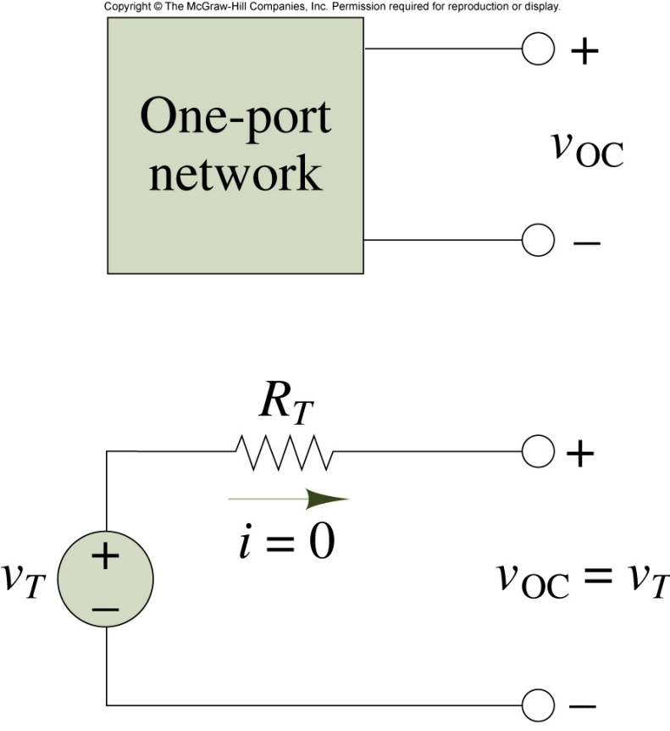
Open-circuit and Thévenin voltage

Slide 51
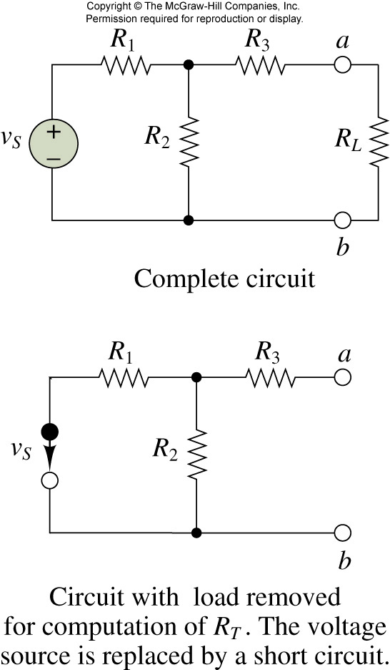
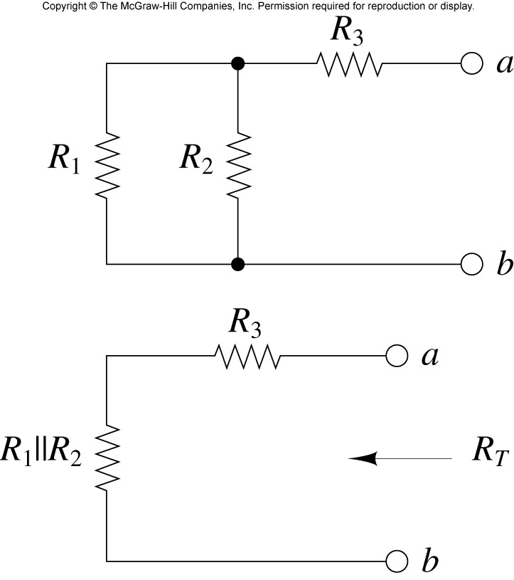
Computation of Thévenin resistance

Slide 52

Example

Slide 53

A circuit and its Thévenin equivalent

Slide 54

Norton equivalent circuit

Slide 55

Illustration of Norton theorem

Slide 56

Computation of Norton current

Slide 57
Example
1kΩ
+
2V
2mA
4Ω
(a)

Slide 58
Exercise
Obtain Thevenin and Norton equivalent circuits
2Ω
3Ω
2Ω
3Ω
A
B
C
A
i₁
B
i
C
>
i₁
+
-
+
v
-
i₁
+
-
i₁
4V
+
D
4V
+
D
1Ω
1Ω
E
E

Slide 59
Source Transformation
R_{th}
A
A
A
Linear
Circuit
Other
Circuit
Other
Circuit
+
v_{oc}
B
B
(a)
(b)
Thevenin
A
i_{sc}
Other
Circuit
R_{th}
B
(c)
Norton

Slide 60

Measurement of open-circuit voltage and short-circuit current

Slide 61
Conclusion
Network analysis: node analysis and mesh analysis
Superposition principle: linear circuit
Thevenin and Norton equivalent circuits

